Slide 1

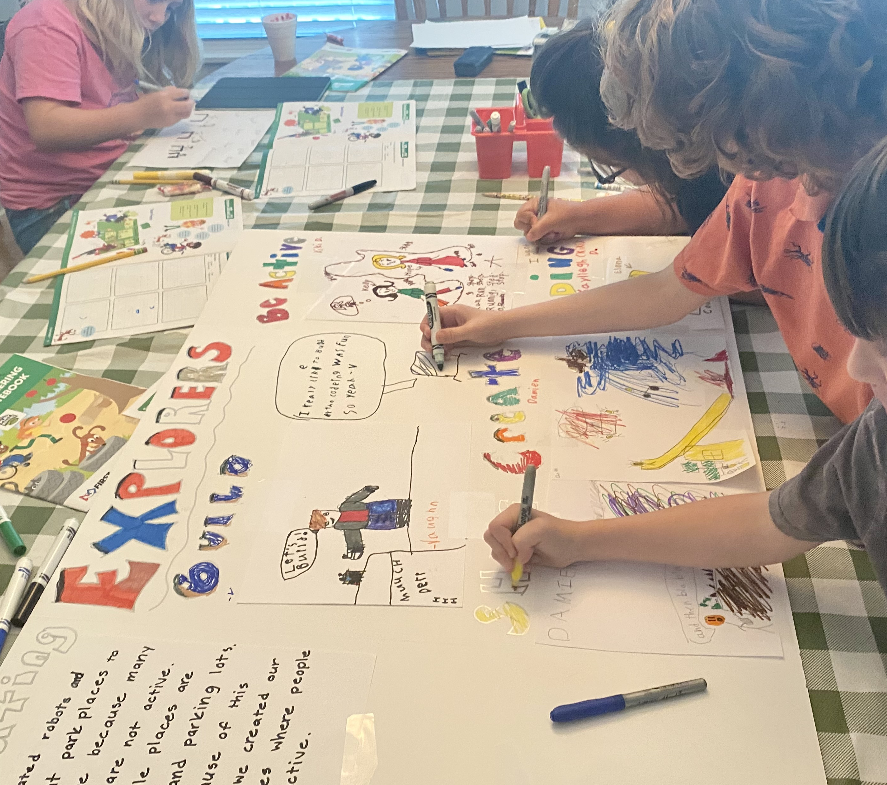
SESSIONS 10 & 11
Make Team Poster

Slide 2
Guiding Questions
What different challenges did you explore?
What did you create and build?
Outcomes
The team will create a plan for what they will include on their team poster.
The team will design and create their team poster.
How can you show your team journey on the poster?
What will you include on your team poster?
Notes:
Each session has Guiding Questions that can be shared to frame the session.​
Session Tips
You will need to provide a large poster board and various art supplies. A trifold poster board works well.
The goal is for the team to create the board themselves. You can support them and provide insight.
The team can look back at the Team Journey and Core Values pages in their Engineering Notebooks.
Sample topics for the poster are provided for the students. They can choose to include whatever they want!
Provide extra scrap paper for the team to draw and write their ideas for their team poster.
Two boxes would fit on each fold on a trifold poster board.

Slide 3



Introduction – Innovation Build
Session 10
Examples of Innovation
Ask the students to provide examples of Innovation and record them here
Example of Innovation
Example of Innovation
We used creativity and persistence to solve problems.
Notes:
***Skip this slide during session 11***
Introduction
Innovation and Inclusion Builds
(10 minutes)
Have the team provide examples of how they have used innovation (Session 10) and inclusion (Session 11) throughout the sessions.
Have the team create a build from the prototyping pieces representing this Core Value or examples of the team using innovation and inclusion.

Slide 4

Introduction – Inclusion Build
Session 11
Examples of Inclusion
Ask the students to provide examples of Inclusion and record them here
Example of Inclusion
Example of Inclusion
We respected each other and embraced our differences.
Notes:
***Skip this slide during session 10***
Introduction
Innovation and Inclusion Builds
(10 minutes)
Have the team provide examples of how they have used innovation (Session 10) and inclusion (Session 11) throughout the sessions.
Have the team create a build from the prototyping pieces representing this Core Value or examples of the team using innovation and inclusion.

Slide 5







Tasks
You need…
Describe
your team
journey
throughout the
sessions.
Make a team
poster sharing
what you learned
about CARGO
CONNECTSM!
Notes:
Tasks (80 minutes)
Find your poster board and art supplies.
Brainstorm what to put on your poster.
Use the next page as a draft for your ideas.
Work together to create your team poster. Teamwork!
You can use words, drawings, and photos on your poster.

Slide 6
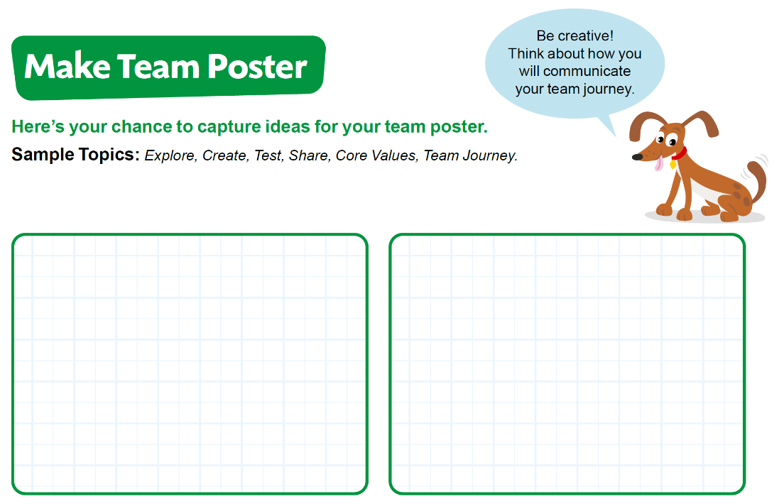
Tasks
Brainstorm what to put on your poster.
Use page 25 in your Engineering Notebook to draft your ideas.
Notes:
Tasks (80 minutes)
Find your poster board and art supplies.
Brainstorm what to put on your poster.
Use the next page as a draft for your ideas.
Work together to create your team poster. Teamwork!
You can use words, drawings, and photos on your poster.

Slide 7
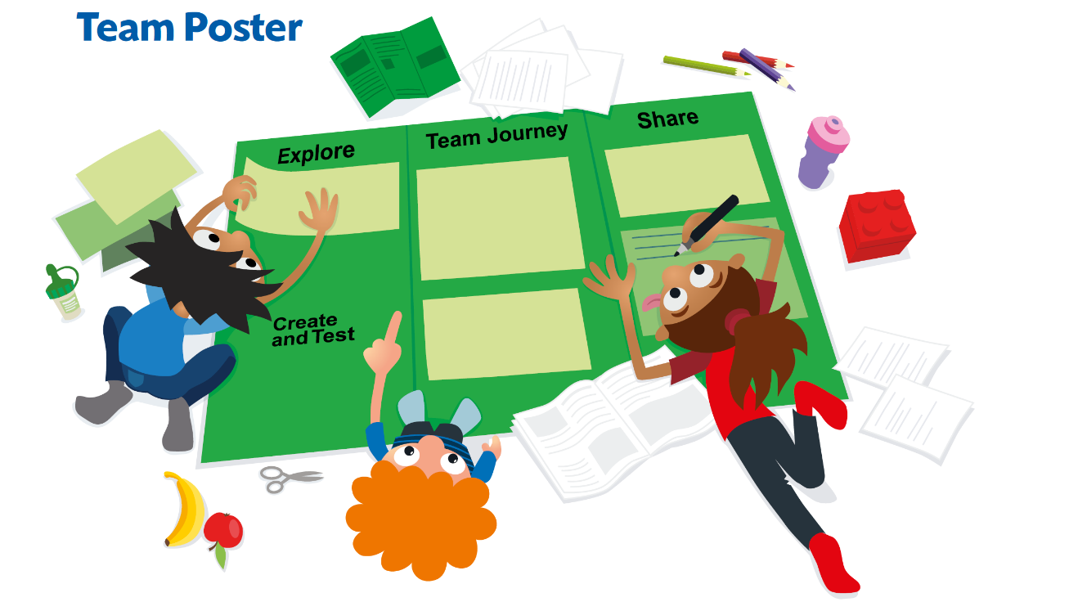
Tasks
Work together to create your team poster. Teamwork!
You can use words, drawings, and photos on your poster.
Notes:
Tasks (80 minutes)
Find your poster board and art supplies.
Brainstorm what to put on your poster.
Use the next page as a draft for your ideas.
Work together to create your team poster. Teamwork!
You can use words, drawings, and photos on your poster.

Slide 8

Share
Share what you did at the end of each session.
Show your team poster design.
Explain your team journey.
Demonstrate how you will present your team poster.
Notes:
Share (10 minutes)
Have the team:
Share what they did at the end of each session.
Show their team poster design.
Explain their team journey.
Demonstrate how they will present their team poster.

Slide 9

Optional Video:
You may wish to embed a relevant, age-appropriate video for your students here. See the Notes for an example.
Notes:
Choose a relevant, age-appropriate video for your students to show examples of what they will experience at an event.
Search for “FIRST LEGO League Explore Events” to find example videos.
Here is one example that is a recap of what teams experienced at the 2019 FIRST LEGO League World Festival in Houston. Examples of team posters are shown. https://youtu.be/tlUc27c86zM

Slide 10

Clean Up
Notes:
You may wish to play a video or song during clean up time Link on GoNoodle: https://family.gonoodle.com/activities/clean-up. Link on YouTube Kids: https://www.youtubekids.com/watch?v=ZJFk87ZsHn0 . Link on Youtube: https://youtu.be/ZJFk87ZsHn0
Cleanup Pointers
Make sure you have a safe place to store the poster, especially if it needs to lay open to dry.
You may need extra time at the end of each session to clean up the art supplies.

Slide 11
FIRST® and the FIRST® logo are registered trademarks of For Inspiration and Recognition of Science and Technology (FIRST). LEGO® is a registered trademark of the LEGO Group. FIRST® LEGO® League and CARGO CONNECTSM are jointly held trademarks of FIRST and the LEGO Group. All other trademarks are the property of their respective owners. ©2021 FIRST and the LEGO Group. All rights reserved.

